Slide 1


Anti-Bullying
Week 2021
Primary School
Lesson

Slide 2
?
What is bullying?
Bullying is the repetitive, intentional hurting of one person or group by another person or group, where the relationship involves an imbalance of power. It can happen face to face or online.
Video: https://youtu.be/U8iX-rstY9I
Anti-Bullying Week 2021 – One Kind Word
2

Slide 3
?
How does being bullied make someone feel?
Think / Pair / Share
Anti-Bullying Week 2021 – One Kind Word
3

Slide 4
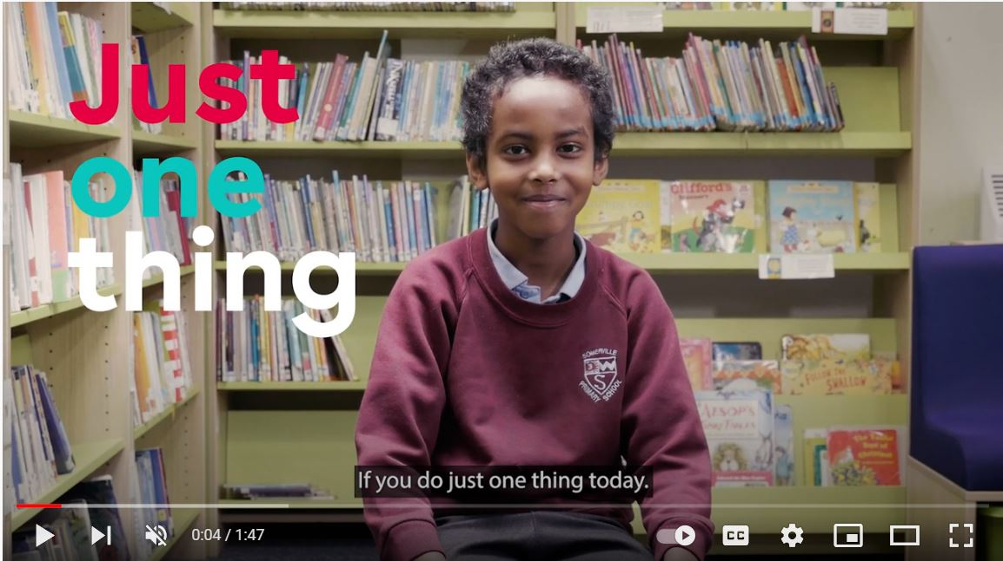


“
“
https://youtu.be/oJQg2JyQ3mM
Anti-Bullying Week 2021 – One Kind Word
4

Slide 5
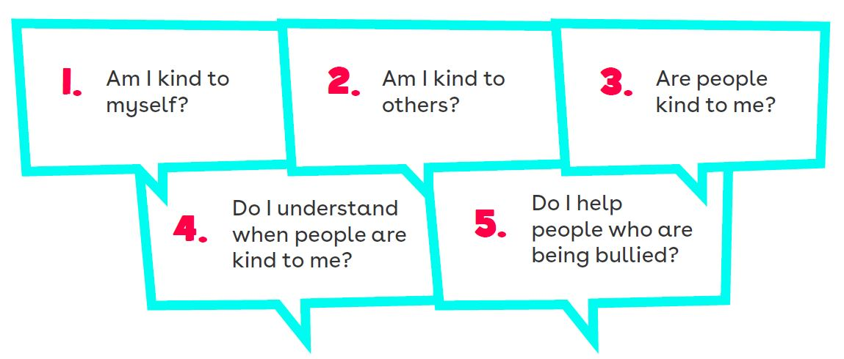
5 Key Kindness Questions
Anti-Bullying Week 2021 – One Kind Word
5

Slide 6
Situation
1
You see Tomas sending Molly unkind messages on Roblox
What could you do to spread kindness and stop bullying?
Anti-Bullying Week 2021 – One Kind Word
6

Slide 7
Situation
2
Mohammed is looking sad after Grace called him names for forgetting his costume for ‘Tudors Day’
What could you do to spread kindness and stop bullying?
Anti-Bullying Week 2021 – One Kind Word
7

Slide 8
Situation
3
Henry is getting pushed by other children when they’re standing in line
What could you do to spread kindness and stop bullying?
Anti-Bullying Week 2021 – One Kind Word
8

Slide 9
Situation
4
At choir your friend tells you they don’t like Mya because they don’t like her singing voice
What could you do to spread kindness and stop bullying?
Anti-Bullying Week 2021 – One Kind Word
9

Slide 10
Thank you for being a part of
Anti-Bullying
Week 2021

